Slide 1
Returning to work Covid-19 Induction

Slide 2
Induction
Induction – What we’ll cover today
Brief
Keeping 2 metres
Access and travel to site
Hand washing
Toilet facilities
Canteens and eating arrangements
Changing
Avoiding close working
cleaning
If you or someone fall ill
Use of PPE
Company drivers and accessing other sites
Visitors and Contractors
Concerns

Slide 3
Brief
The following measures are set out to allow us to continue operating during the Coronavirus Covid-19 pandemic. We need to ensure they are understood by all employees to protect our workforce and minimise the risk of spreading infection.
This guidance is intended to introduce consistent measures on sites of all sizes in line with the Government’s recommendations on social distancing.
These are exceptional circumstances and the industry must comply with the latest Government advice on Coronavirus at all times.
The health and safety requirements of any activity must also not be compromised at this time. If an activity cannot be undertaken safely due to a lack of suitably qualified personnel being available or social distancing being implemented, it should not take place.

Slide 4
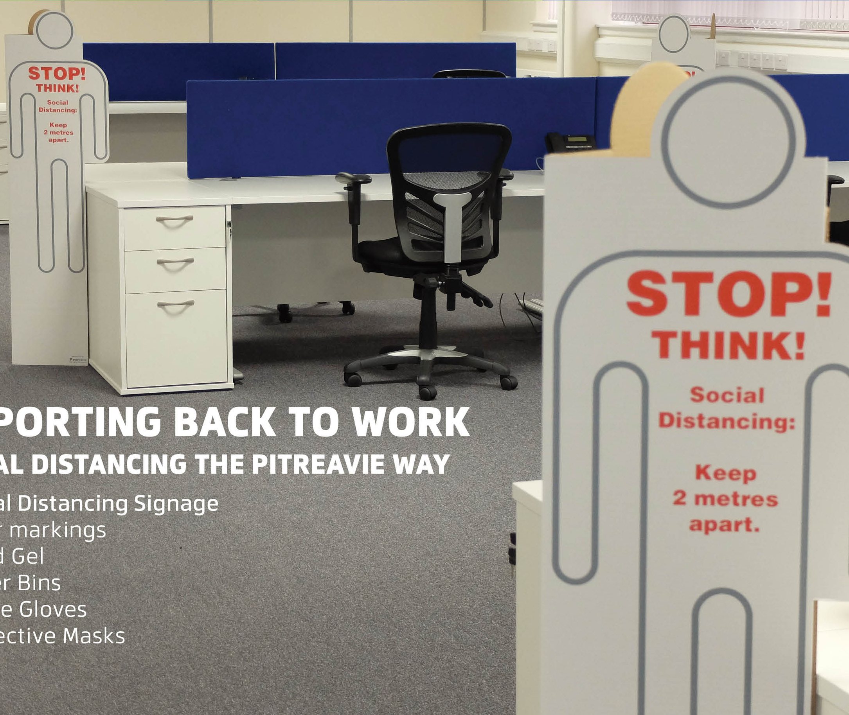
Keeping 2 metres
These social distancing markers have been designed and introduced to all Company sites. They should be positioned throughout your place of work, between desks, Machines, walkways and canteens. They are a reminder to keep your distance and also act as a divider to those sat at desks.

Slide 5
Access and travel to site
Wherever possible workers should travel to site alone using their own transport
Avoid public transport were possible.
Walk or cycle if you are able to
Allow plenty of space (two metres) between people waiting to enter site
Continue to adhere to social distancing guidelines once in side
All workers are required to wash or clean their hands before entering or leaving the site

Slide 6
Hand Washing
Regular frequent handwashing must be carried out
Signs giving Hand washing techniques are located at wash stations.
Signs giving Hand gel techniques are located at gel points
Additional hand sanitisers have been put in place, where hand washing facilities are unavailable
Rubbish bins for hand towels with regular removal and disposal

Slide 7
Toilet facilities
Avoid overcrowding in the toilet facilities at any one time
Wash your hands after using the facilities
The use of hand dryers is recommended
Or paper hand towels, disposed of safely in the allocated bins

Slide 8
Canteen and Eating arrangements
There is a requirement for sites to provide a means of heating food and making hot drinks, during these exceptional circumstances we ask you where possible to make arrangements that reduce your use of these items.
Only one person at a time in the kitchen if social distancing rules cannot be met
Ceasing of making colleagues drinks
Break times staggered to reduce congestion and contact at all times
Hand washing by all workers before and after eating.
You are kindly asked to bring pre-prepared meals and refillable drinks bottles from home
Sit 2 metres apart from each other whilst eating and avoid all contact
Not using communal eating utensils, cups etc. Consider environmentally friendly disposable items if possible.
Tables should be cleaned after your use, All rubbish should be put straight in the bin and not left for someone else to clear up
Where vending machines are in site, alcohol wipes are provided to ensure the touchpads can be cleaned after use

Slide 9
Changing
Should you need to change on site
Discuss with your manager a staggered start and finish time to reduce congestion and contact at all times
Ensure you tidy up after yourself, do not leave this to others.
Should you need to wipe down any surfaces this should be done with alcohol wipes
Suitable and sufficient rubbish bins are located in these areas with regular removal and disposal.

Slide 10
Avoiding Close working
There will be situations where it is not possible or safe for workers to distance themselves from each other by 2 metres.
General Principles
Non-essential physical work that requires close contact between workers should not be carried out
Work requiring skin to skin contact should not be carried out
Keep activity time as short as possible
Reduce the number of people each person has contact with by using fixed teams or partnering. (So each person works with only a few others.)
Single use PPE should be disposed of so that it cannot be reused
Increase ventilation in enclosed spaces
Regularly clean the inside of vehicle cabs and between use by different operators.
Site Meetings
Only absolutely necessary meeting participants should attend
Attendees should be two metres apart from each other
Rooms should be well ventilated / windows opened to allow fresh air circulation
Consider holding meetings in open areas where possible.

Slide 11
Cleaning
Enhanced cleaning procedures should be in place across the site, particularly in communal areas and at touch points including:
Taps and washing facilities
Toilet flush and seats
Door handles and push plates
Hand rails on staircases and corridors
Lift and hoist controls
Machinery and equipment controls
Food preparation and eating surfaces
Telephone equipment
Key boards, photocopiers and other office equipment
Rubbish collection and storage points should be increased and emptied regularly throughout and at the end of each day.
You are asked to tidy up after yourself and not leave it for others.

Slide 12
If you or someone falls ill
Anyone who meets one of the following criteria should not come to site:
Has a high temperature or a new persistent cough or loss of taste and sense of smell - follow the guidance on self-isolation
Is a vulnerable person (by virtue of their age, underlying health condition, clinical condition or are pregnant)
Is living with someone in self-isolation or a vulnerable person.
If a worker develops a high temperature or a persistent cough while at work, they should:
Return home immediately
Avoid touching anything
Cough or sneeze into a tissue and put it in a bin, or if they do not have tissues, cough and sneeze into the crook of their elbow.
If they are unable to make their way home. They must be put in an isolated room until arrangements are made to get them home or to a health facility
They must then follow the guidance on self-isolation and not return to work until their period of self-isolation has been completed.

Slide 13
Use of PPE
Where Risk Assessment identifies wearing of PPE as a requirement of the job, an adequate supply of these will be provided.
Face masks are supplied should you wish to wear one but must be disposed of safely.
Disposable gloves are available should you need them but should be disposed of safely.
Avoid where possible the use of Re-usable PPE, Should this be required to carry out a job then it is to be thoroughly cleaned after use.
Single use PPE should be disposed of so that it cannot be reused
You are reminded that wearing of gloves is not a substitute for good hand washing regimes.
Uniforms and workwear being used require regular laundering after each use.

Slide 14
Company drivers and accessing other sites
Any drivers and employees visiting another site are to adhere to all existing site rules.
Drivers should remain in their vehicles if the load will allow it.
Make contactless deliveries where possible.
They must wash or clean their hands before unloading goods and materials
Only visit the workplace if the meeting cannot be done via Zoom or telephone call.
Please use the hand sanitisers, before you enter offices.
Please observe the advised 2m distance between employees.

Slide 15
Visitors and contractors
Non essential visitors prohibited
Only have essential visitors attend the workplace. If the meeting can be done via Zoom or telephone call, please do so.
Ensure they use the hand sanitisers located before they enter the offices.
Observe the advised 2m distance between employees.

Slide 16
Concerns
Concerns
If you have any concerns please speak to your manager who will address these for you. As this is an unusual circumstance, they may not have the answers straight away. But they will do their best to find you the answers.
These forms and letters should be used as a guide and adapted to suit your own circumstances. We suggest you seek advice and guidance before issuing. The HR Booth does not accept any liability arising from any issues raised as a result of this document.

